Slide 1
Unit 10
I’d like some noodles.
Section B 2a-2c
七年级(下)

Slide 2

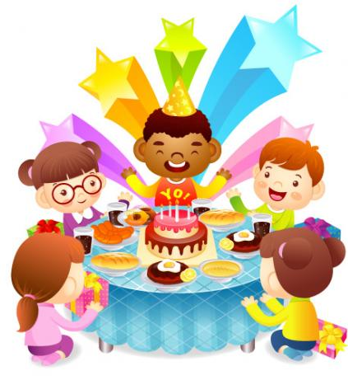
2a
What do you do or eat on your birthday?
I usually have a birthday party. My friends come to my party. We have a great time.

Slide 3
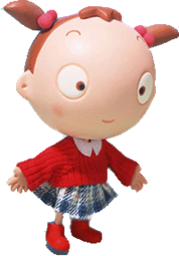
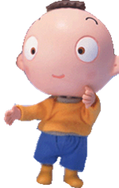
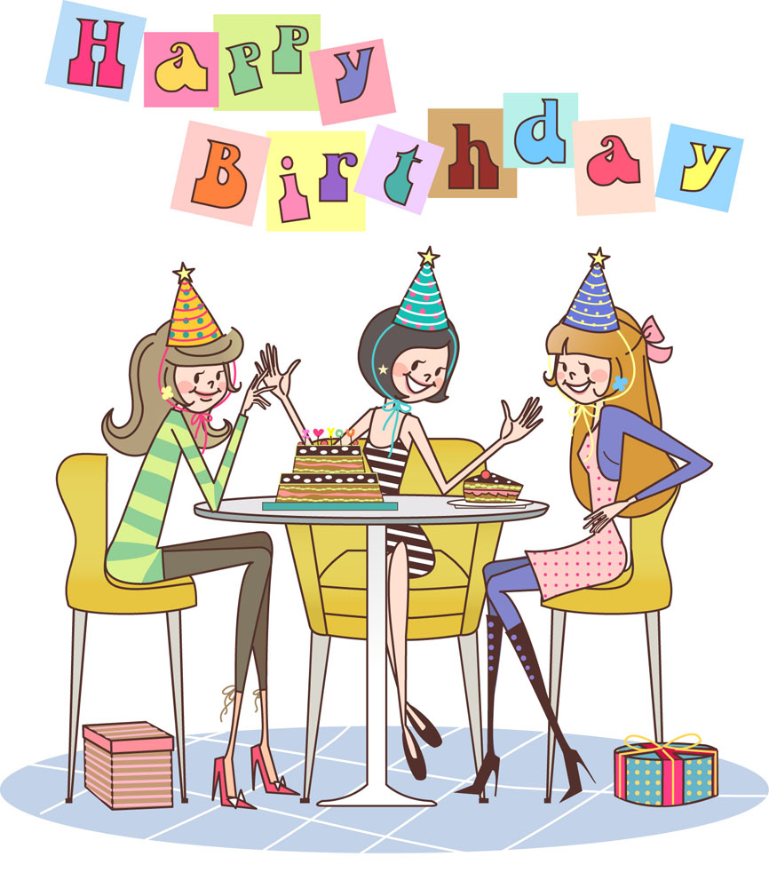
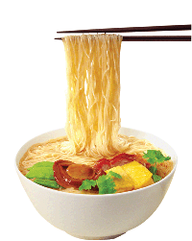
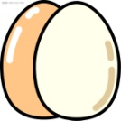
I usually make a wish and blow out the candles.
I usually eat noodles and eggs for breakfast.

Slide 4
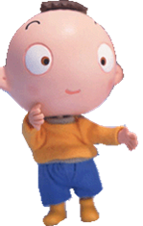
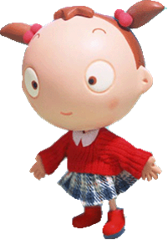
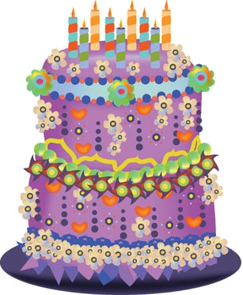
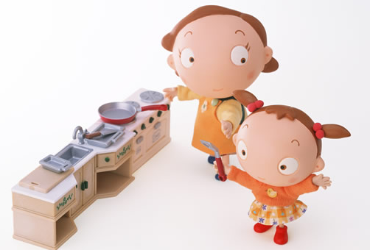
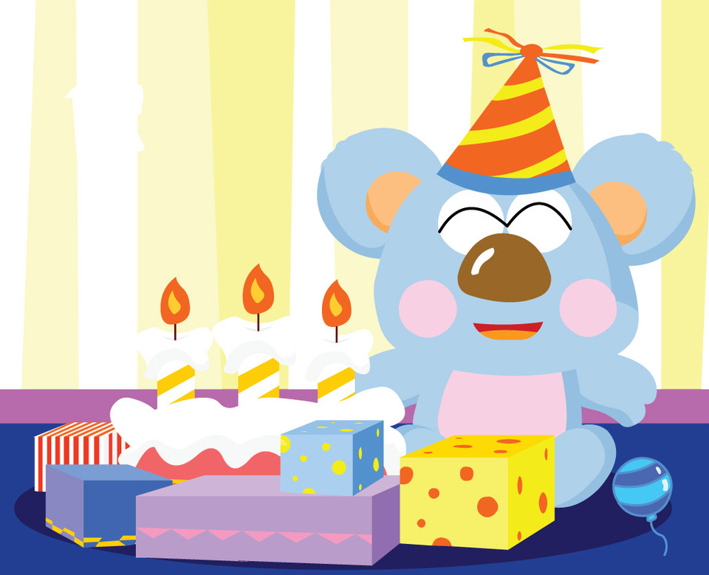
I can have a big birthday cake and a lot of gifts.
My mum usually makes a big dinner for me.

Slide 5
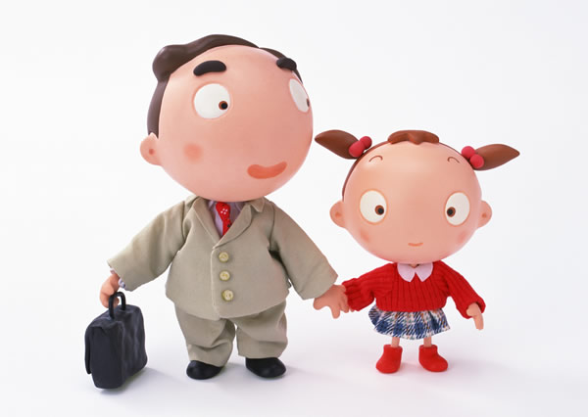

I can get many good books on my birthday.
My father usually buys me some new clothes.

Slide 6

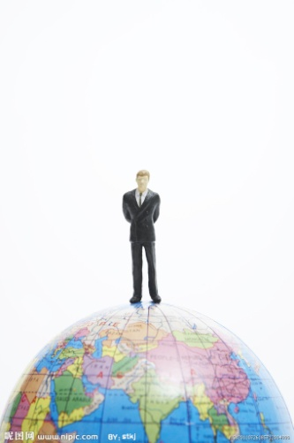
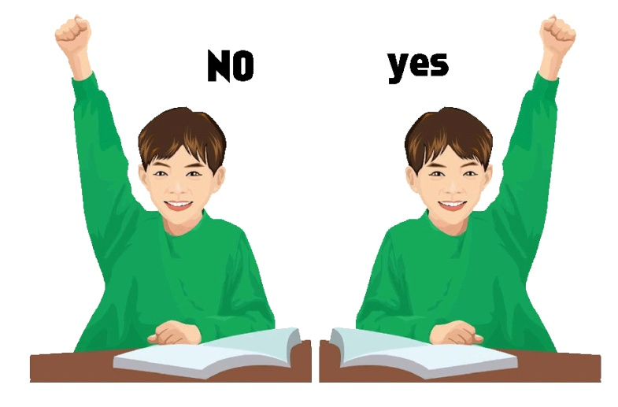
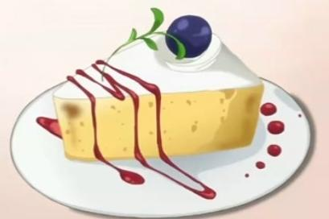
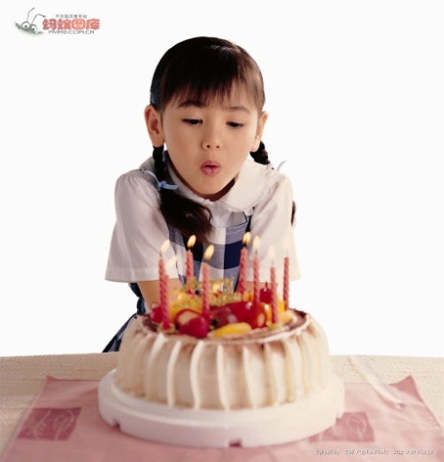
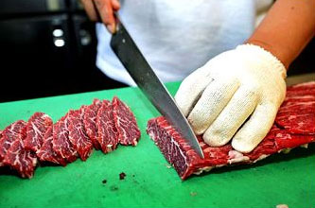
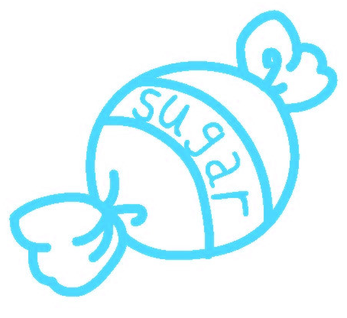
world
answer
cake
blow
candy
cut up

Slide 7
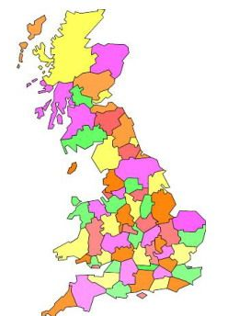
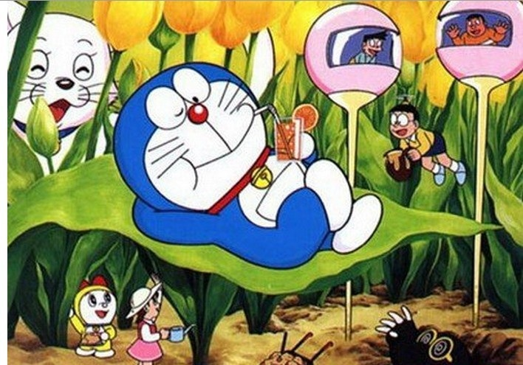
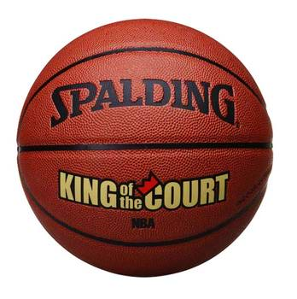

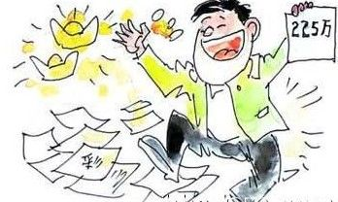
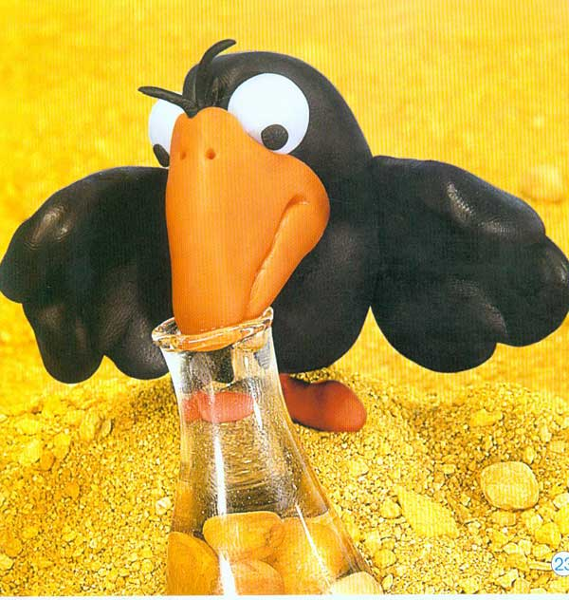
different
UK
popular
lucky
idea

Slide 8

Read the passage. Judge Yes (Y) or No (N) of the sentences.
2b
____ The number of candles on the birthday cake is the person’s age.
____ In the UK, when the child has the birthday cake with the candy, he/she is lucky.
Y
Y

Slide 9
3. ____ In China, people eat noodles on their birthday, we never have cake.
4. ____ People in different countries have different birthday foods.
N
Y

Slide 10

Read the article about food traditions and complete the chart.
Country | Food | Special meaning
UK
China

Slide 11

Country | Food | Special meaning
UK
China
birthday cake with a candy
The child with the candy is luck.
long noodles
a symbol of long life
eggs
a symbol of life and good luck

Slide 12


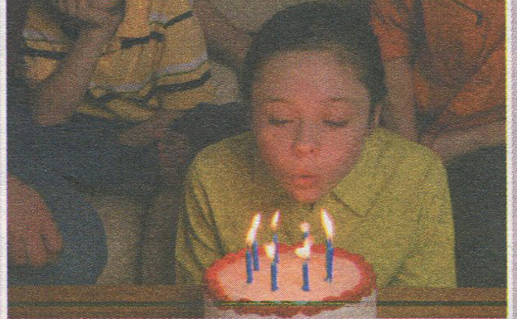
Birthday Food Around the World
What
_______ would people like to eat on
their birthday? The answer would
be _______ in different countries.
In many countries, people have
_____________ with candles. The number
of candles is the person’s age. The
_______________ must make a wish and
_______ the candles. If he or she blows
different
birthday cakes
birthday person
blow out

Slide 13
out all the candles in one go, the wish will _________. In the UK, people sometimes put a candy in the birthday cake. The child with the candy is lucky.
In ________, it is ______________ to have cake on your birthday. But many people still eat very _______________________
__________. They never cut up the noodles
because the long noodles are a symbol of long life. In some places, Chinese people
come true
China
getting popular
long noodles for their
birthday

Slide 14
also eat eggs on their birthday. They are a symbol of life and ___________.
All of these birthday foods may be different, but the ideas are __________. They bring good luck to the birthday person.
good luck
the same

Slide 15

Read the article again and answer the questions.
2c
How can a person make his or her birthday wish come true?
__________________________________
2. What do people in the UK sometimes put in a birthday cake?
___________________________________

Slide 16
3. Why do people never cut up birthday noodles in China?
__________________________________
4. Why do people eat special foods on their birthday?
__________________________________

Slide 17

How can a person make his or her birthday wish come true? __________________________________________________________________
2. What do people in the UK sometimes put in a birthday cake?
_________________________________ _________________________________
If he or she blows out all the candles
in one go, the wish will come true.
They usually put a candy in a birthday
cake.

Slide 18
3. Why do people never cut up birthday noodles in China? _________________________________
_________________________________
4. Why do people eat special foods on their birthday? __________________________________________________________________
Because the long noodles are a symbol of long life.
Because they want to bring good luck to the birthday person.

Slide 19


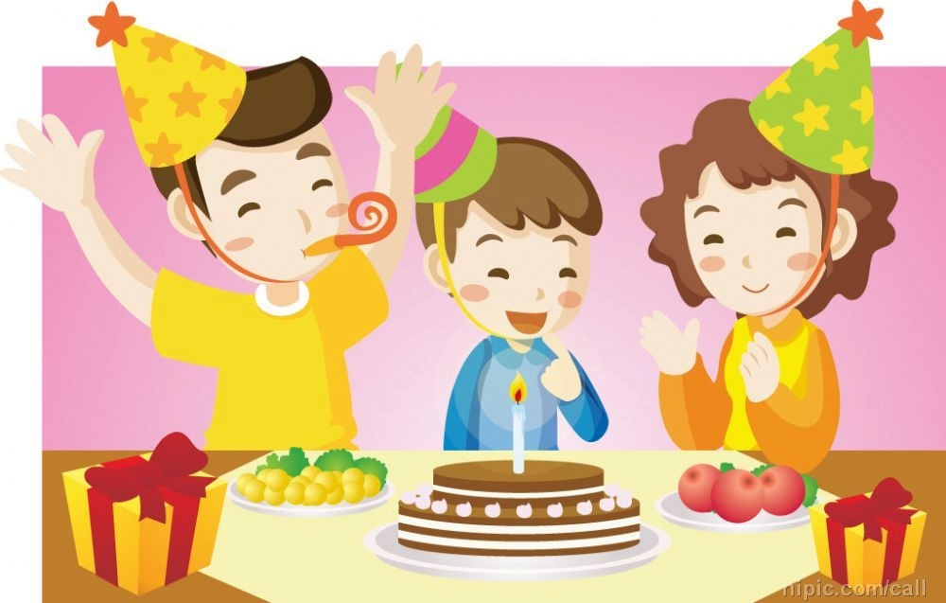
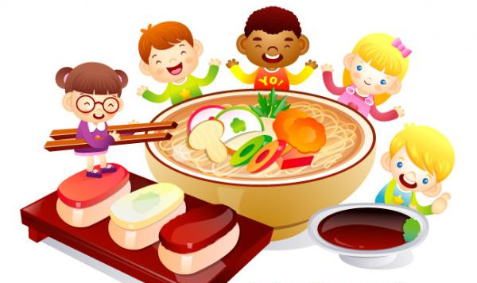
What would people like to eat on their birthday? The answer would be different in different countries.

Slide 20
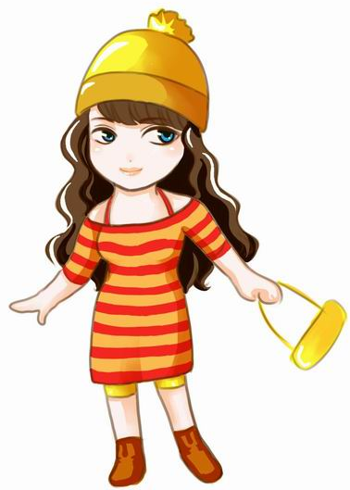
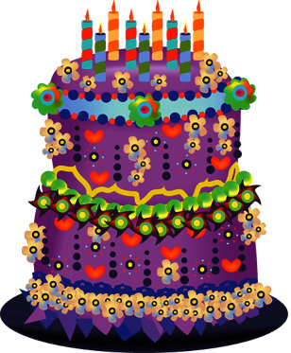
There’re 9 candles and I’m nine years old.
In many countries, people have birthday cakes with candles. The number of the candles is the person’s age.

Slide 21
The birthday person must make a wish and blow out the candles. If he or she blows out all the candles in one go, the wish will come true.

Slide 22

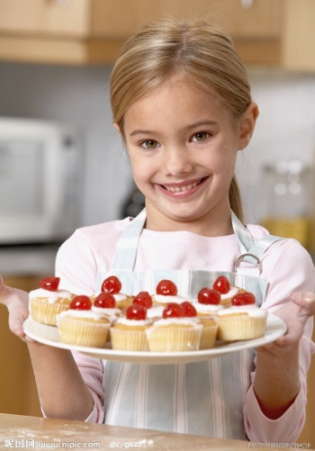
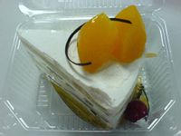
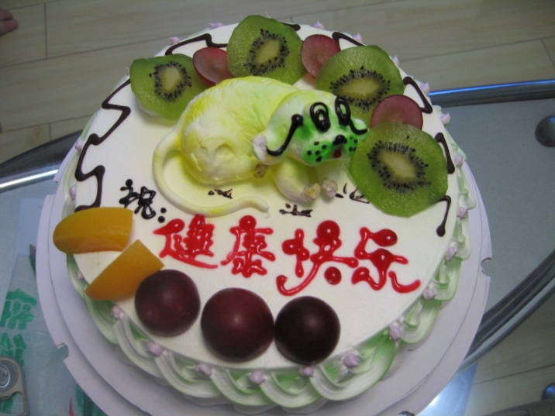
In the UK, people sometimes put a candy in a birthday cake. The child with the candy is lucky.
In China, it is getting popular to have a cake on your birthday.

Slide 23
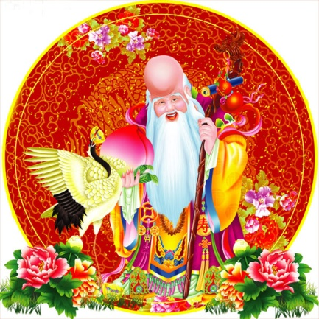
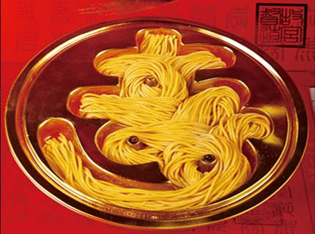
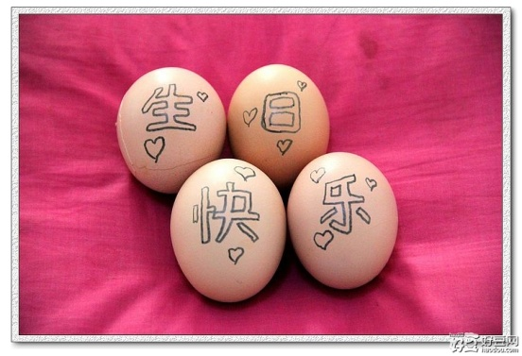
But many people still eat very long noodles for their birthday. They never cut up the noodles because the long noodles are a symbol of long life.
In some places, Chinese people also eat eggs on their birthday. They are a symbol of life and good luck.

Slide 24
Language Points
1. around the world 意为“世界各地”。
他想环游世界。
He would like to take a trip around the world.
2. The number of the candles is the person’s age.
蜡烛的数量是这个人的岁数。

Slide 25
the number of 意为“……的数目”，当其作主语时，谓语动词应用单数形式。
我们班里学生的数目是四十人。
The number of the students in our class is forty.
【拓展】
a number of 意为“很多的；大量的”后跟可数名词复数形式。

Slide 26
今天有很很多人在公园里。
A number of people are in the park today.
3. age 意为“年龄”。
他多大年龄？
What’s his age?
(= How old is he?)

Slide 27
4. If he or she blows out all the candles in one go, the wish will come true.
如果他(她)一口气把蜡烛全部吹灭的话，许的愿望便会成真。
in one go 相当于汉语中的“同一次”，“一次性地”，其中的介词还可用at，即at one go。例如：
You can’t do the work all in one go.
你不可能一次把工作都干完。

Slide 28
2) come true 表示愿望、梦想等的“实现”或“成为现实”。例如：
Make a wish, and it can really come true.
许个愿，它一定会实现的。
Keep on working and your dream will come true.
不断干下去，你的梦想会实现的。

Slide 29
5. lucky 形容词， 意为“幸运的”；而
luck 是名词，意为“运气”。
她真是一个幸运的女孩。
She’s really a lucky girl.
鸡蛋是生命和好运的象征。
Eggs are a symbol of life and good luck.

Slide 30
6. different 是形容词，意为“不同的”。
他们两个在不同的班级。
They’re in different classes.
【拓展】
differently 是副词，意为“不同地”
他们的想法不同。
They think differently.

Slide 31
7. drink n. 饮料
e.g. Do you want some drink?
你要点饮料吗？
drink可以用作动词：
e.g. Do you want to drink something?
你想喝点什么吗？

Slide 32

luck, lucky, different, age, answer, will, idea
选词填空。
age
1. The _____ of the old man is eighty.
2. What’s your _______ to this question?
3. They think it can bring good _____ to them.
4. The boy doesn’t get hurt (受伤). He’s really ______.
answer
luck
lucky

Slide 33
5. If it’s sunny tomorrow. We _____ go boating.
6. The two boys have ________ hobbies (爱好).
7. It’s a good _____ to make a snowman in the snow.
will
different
idea

Slide 34

一、熟读2b中的短文。
二、用下列词汇造句：
1. around the world
2. in different countries
3. the number of 4. blow out
5. in one go 6. come true
7. get popular 8. cut up

Slide 35
Thank You!

